Slide 1
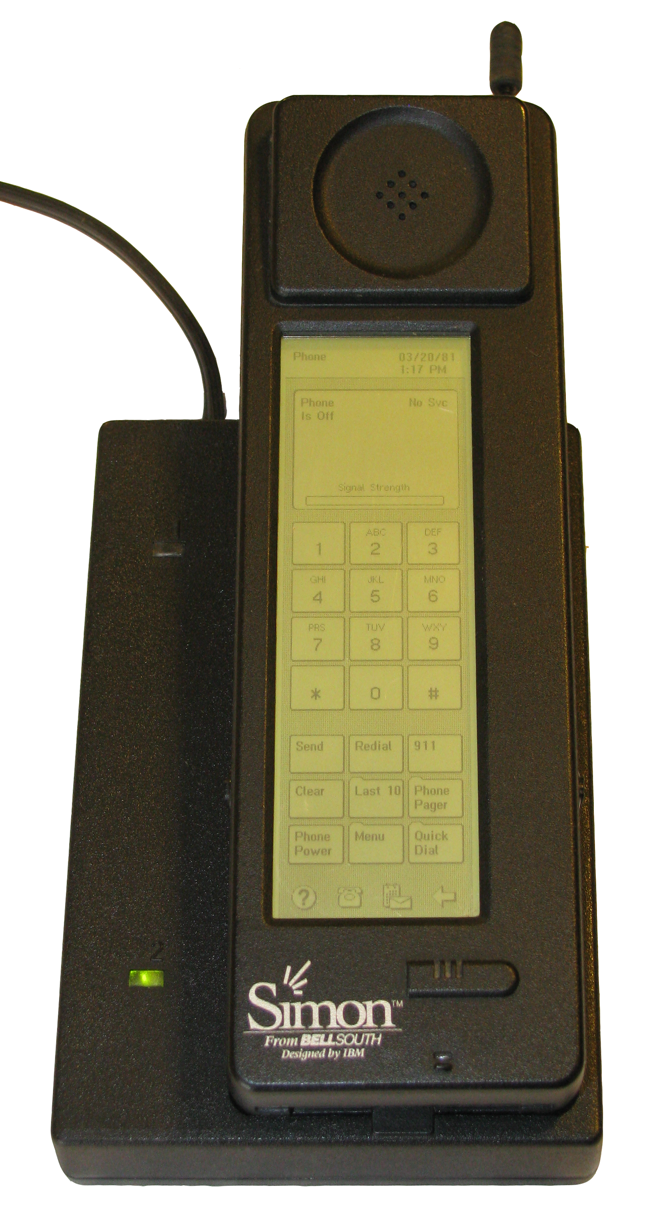
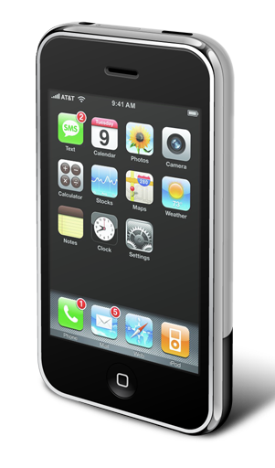
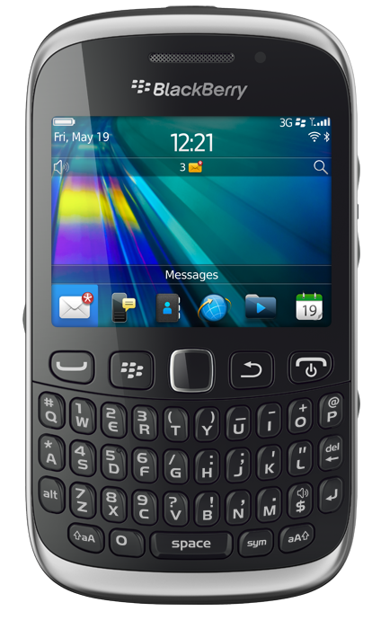


History Of Mobile Application
THIS DAY IN HISTORY
1994
2002
2007
2008
2012
2014
2017
IBM Simon releases as first smartphone with 10 built-in apps.
Blalckberry 5810 smartphone releases with wireless email & built-in app.
Apple release first iphone with new built-in apps never before seen. (Maps, Photos, Weathers.
The first ever third-part allowed app store lunches with the istore. 500 apps in store.
Google Release all of its content under one platform: Google Play Store
Applications are now downloaded to alternative devices outside of the mobile phone with watches, tablets, and TV’s
Brands begin outlining separate mobile campaigns strictly for app users.

Slide 2
History Of Mobile Application
THIS DAY IN HISTORY
2018
2019
2007
2008
2012
2014
2017
IBM Simon releases as first smartphone with 10 built-in apps.
Blalckberry 5810 smartphone releases with wireless email & built-in app.
Apple release first iphone with new built-in apps never before seen. (Maps, Photos, Weathers.
The first ever third-part allowed app store lunches with the istore. 500 apps in store.
Google Release all of its content under one platform: Google Play Store
Applications are now downloaded to alternative devices outside of the mobile phone with watches, tablets, and TV’s
Brands begin outlining separate mobile campaigns strictly for app users.

